Slide 1


Evaluating the safest borough in New York
Social Network Analysis
Presented By – Apurva Gandhi
CWID 20034075

Slide 2
Problem Statement
To assess public safety across New York City’s boroughs by analyzing the ‘NYPD_Complaint_Data_Year_To_Date_2024’ dataset, on crime patterns, hotspots, and safer time windows
Context:
New York City continues to attract millions of residents and tourists each year, making public safety a critical component of urban planning, tourism strategy, and community well-being. Understanding crime trends at the borough level, across time periods, and by type of victim or crime can support more targeted policy responses and personal safety recommendations.

Slide 3
Project Objectives
Identify Influencing Factors:
Analyze the crime rate in New York’s 5 boroughs
Understand Trends:
Discover patterns in number of crimes committed over time (e.g., what time of the year do the crimes spike, what time of day are the crime rates highest).
Support Data-Driven Decisions:
Provide insights for different type of user – residents, tourists and police authorities for further analysis

Slide 4
Data Introduction
Column Name | Column Description
CMPLNT_NUM | Randomly generated persistent ID for each complaint
ADDR_PCT_CD | The precinct in which the incident occurred
BORO | The name of the borough in which the incident occurred
CMPLNT_FR_DT | Exact date of occurrence for the reported event (or starting date of occurrence, if CMPLNT_TO_DT exists)
CMPLNT_FR_TM | Exact time of occurrence for the reported event (or starting time of occurrence, if CMPLNT_TO_TM exists)
CMPLNT_TO_DT | Ending date of occurrence for the reported event, if exact time of occurrence is unknown
CMPLNT_TO_TM | Ending time of occurrence for the reported event, if exact time of occurrence is unknown
CRM_ATPT_CPTD_CD | Indicator of whether crime was successfully completed or attempted, but failed or was interrupted prematurely
HADEVELOPT | Name of NYCHA housing development of occurrence, if applicable
HOUSING_PSA | Development Level Code
JURISDICTION_CODE | Jurisdiction responsible for incident. Either internal, like Police(0), Transit(1), and Housing(2); or external(3), like Correction, Port Authority, etc.
JURIS_DESC | Description of the jurisdiction code
KY_CD | 3 digits offense classification code
LAW_CAT_CD | Level of offense: felony, misdemeanor, violation
LOC_OF_OCCUR_DESC | Specific location of occurrence in or around the premises; inside, opposite of, front of, rear of
OFNS_DESC | Description of offense corresponding with key code
PARKS_NM | Name of NYC park, playground or greenspace of occurrence, if applicable (state parks are not included)
PATROL_BORO | The name of the patrol borough in which the incident occurred
PD_CD | 3 digits internal classification code (more granular than Key Code)
PD_DESC | Description of internal classification corresponding with PD code (more granular than Offense Description)
PREM_TYP_DESC | Specific description of premises; grocery store, residence, street, etc.
RPT_DT | Date event was reported to police
STATION_NAME | Transit station name
SUSP_AGE_GROUP | Suspect’s Age Group
SUSP_RACE | Suspect’s Race Description
SUSP_SEX | Suspect’s Sex Description
TRANSIT_DISTRICT | Transit district in which the offense occurred.
VIC_AGE_GROUP | Victim’s Age Group
VIC_RACE | Victim’s Race Description
VIC_SEX | Victim’s Sex Description
X_COORD_CD | X-coordinate for New York State Plane Coordinate System, Long Island Zone, NAD 83, unit- feet (FIPS 3104)
Y_COORD_CD | Y-coordinate for New York State Plane Coordinate System, Long Island Zone, NAD 83, unit- feet (FIPS 3104)
Latitude | Midblock Latitude coordinate for Global Coordinate System, WGS 1984, decimal degrees (EPSG 4326)
Longitude | Midblock Longitude coordinate for Global Coordinate System, WGS 1984, decimal degrees (EPSG 4326)
The Data selected for the study is the NYPD Complaints data for the year 2024. This dataset provides detailed information about the name of borough, type of crime (felony, misdemeanor, violation), Suspect Age and Race, Victim Age and Race, etc.
The original file contains 36 columns and approximately 577109 rows
The summary of the data is shown on the right

Slide 5
Data Selection
For this analysis I filtered out 14 columns (filter out the null values)
CMPLNT_NUM (Complaint Number),
BORO (Bourough name) ,
CMPLNT_FR_DT (Complaint Date) ,
CMPLNT_FR_TM (Time the occurrence of crime),
(CRM_ATPT_CPTD_CD (Attempted/Committed) – filtering only the committed crimes,
LAW_CAT_CD (Type of crime),
SUSP_AGE_GROUP (Suspect Age),
SUSP_RACE (Suspect Race) ,
SUSP_SEX (Suspect Sex),
VIC_AGE_GROUP (Victim Age),
VIC_RACE (Victim Race),
VIC_SEX (Victim Sex) ,
Latitude ,
Longitude

Slide 6
Time Analysis of crime by Year
Hypothesis:
Since the tourists visit to the city during the holiday season, crime rate will be higher at this time of the year (e.g. November and December)

Slide 7
Initial Descriptive Statistics and Visualizations
Observations:
Number of complaints are lowest In Staten Island.
For all other boroughs, the number of complaints are highest from week 21-29 (June to July)
Number of complaints begin to plunge from week 42 (from November to December)
The observations negate our underlying hypothesis

Slide 8
Initial Descriptive Statistics and Visualizations
Observations:
Although Staten Island has the lowest number of compliant reported, but the crimes per capita are highest
Manhattan has the highest density of crime given in crimes per sq.km
Queens has the lowest Crime per capita and crime per sq.km followed by Brooklyn
 | BRONX | BROOKLYN | MANHATTAN | QUEENS | STATEN ISLAND
Total Number of complaints per year | 125671 | 159200 | 138644 | 128164 | 24594
Population | 1500000 | 2700000 | 1700000 | 2400000 | 500000
Crime per Capita (crime/person) | 0.08 | 0.05 | 0.07 | 0.05 | 0.25
 | BRONX | BROOKLYN | MANHATTAN | QUEENS | STATEN ISLAND
Area in sq.km | 148.7 | 251 | 87.5 | 461.7 | 265.5
Crime per sq.km | 845.13 | 500.68 | 1436.24 | 272.19 | 473.34

Slide 9
Possible analysis in future:
Further analysis can be done by the police departments to check why they couldn’t stop these crimes from being committed?
Which department or police station sees the highest crimes reported per year? Is there enough man-force in this station to keep the crime rate under control? Do they need more recruits ?

Slide 10
Data after Filtering
Total rows:59829 (Filtering out all the rows with null values in any of the 14 columns)column
Filtered for months: November and December 2024
Borough names: Manhattan, Brooklyn, Bronx, Queens, Staten Island
Filtered only for crime successfully committed

Slide 11
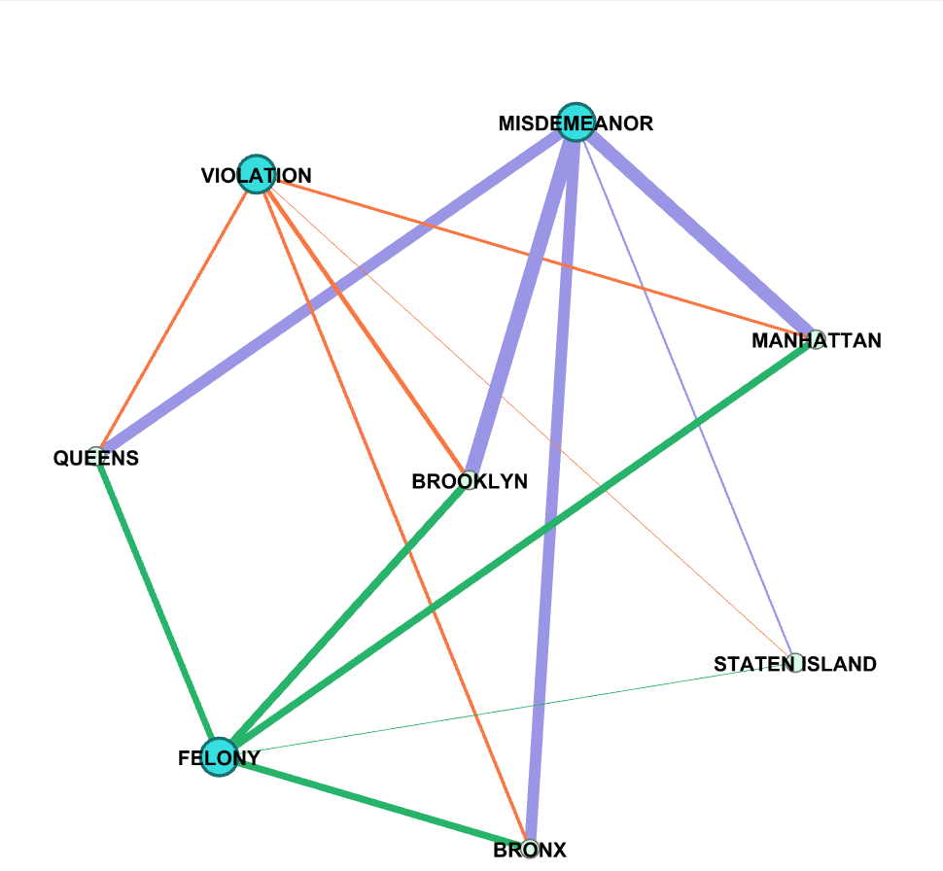
Gephi Social Network Diagram for Crime Data
2694
9933
755
1939
2938
12586
11672
Nodes:
1. Borough Name
2. Type of crime (felony, violation, misdemeanor)
Edges:
Frequency of each type of crime in each borough
9875
3028
4007
5601
6889
6548
858
6108

Slide 12
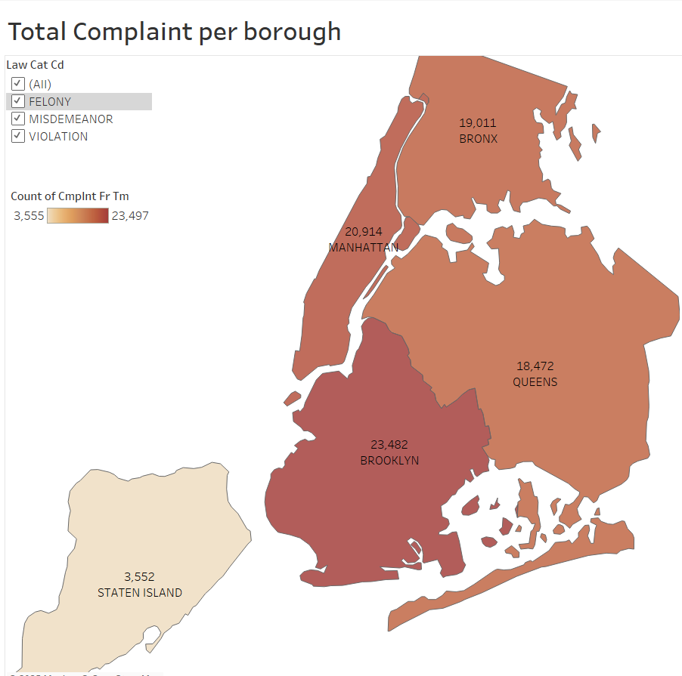
Analyzing the safest borough
Brooklyn has the highest number of total complaints, while Staten Island has the least number of complaints in the month of November and December Combined

Slide 13
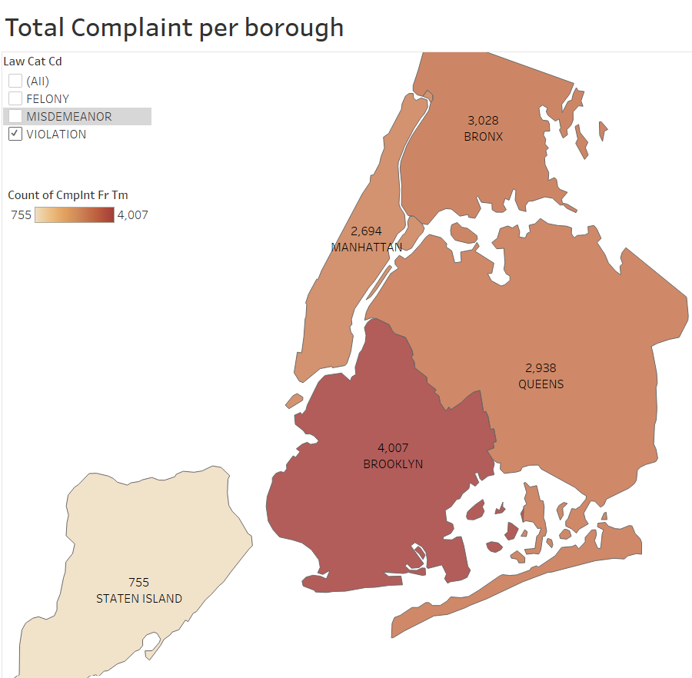
Analyzing the safest borough
The trend of total complaints follows for complaints specific to ‘Violations’.

Slide 14
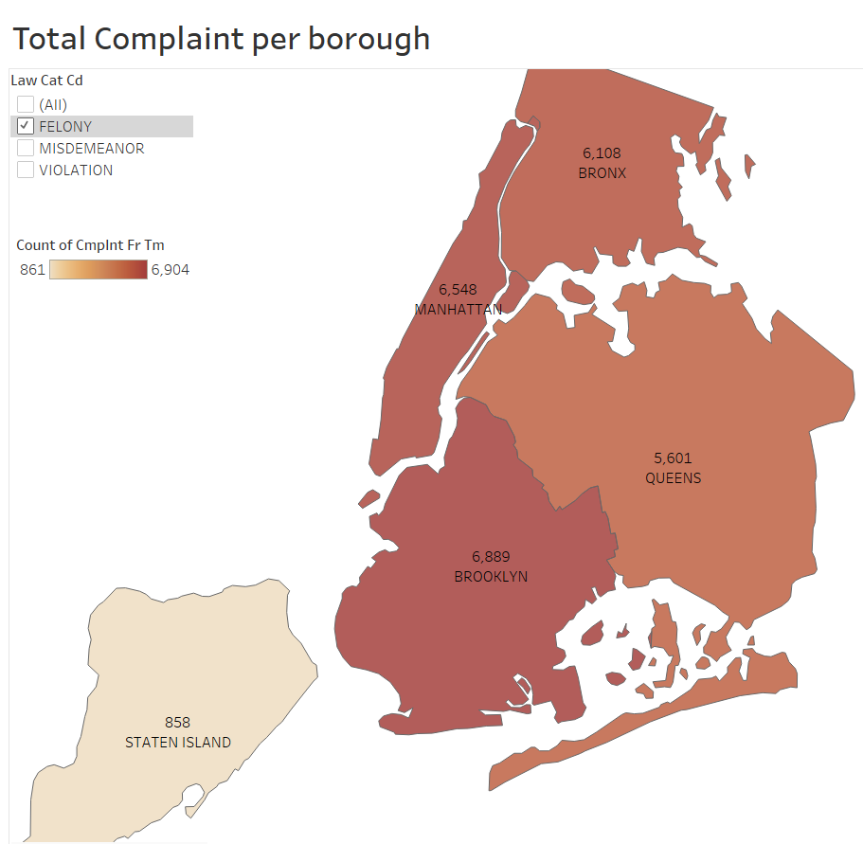
Analyzing the safest borough
The trend of total complaints follows for complaints specific to ‘Felonies’.
However, number of complaints for felony are higher than number of complaints for violation.

Slide 15
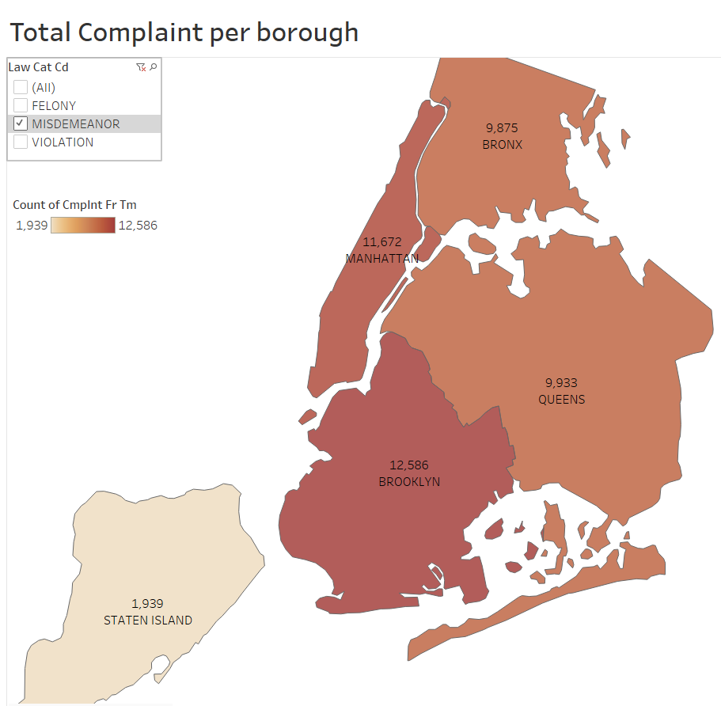
Analyzing the safest borough
The trend of total complaints follows for complaints specific to ‘Misdemeanor’.
We can also see that the number of complaints in each borough is highest for misdemeanor compared to felonies and violations

Slide 16
Future Analysis Possible: (Currently Out of Scope for this study)
Further analysis can be done by the authorities to investigate :
Why are the number of misdemeanor so high?
Are the penalties or punishments not strict enough ?
Do we need to give any civic trainings or run awareness drives to change people’s behavior ?
How can we make the victims more vigilant?

Slide 17
Initial Insights from the study
Based on the number of crimes, we can see that Staten Island is the safest Borough although its crime per capita is the highest. Whereas the number of crimes reported in Brooklyn are highest but its crime per capita is lowest.
Further location analysis in each borough can help us delineate which street/ precinct is the safest in each borough for people to reside in.

Slide 18
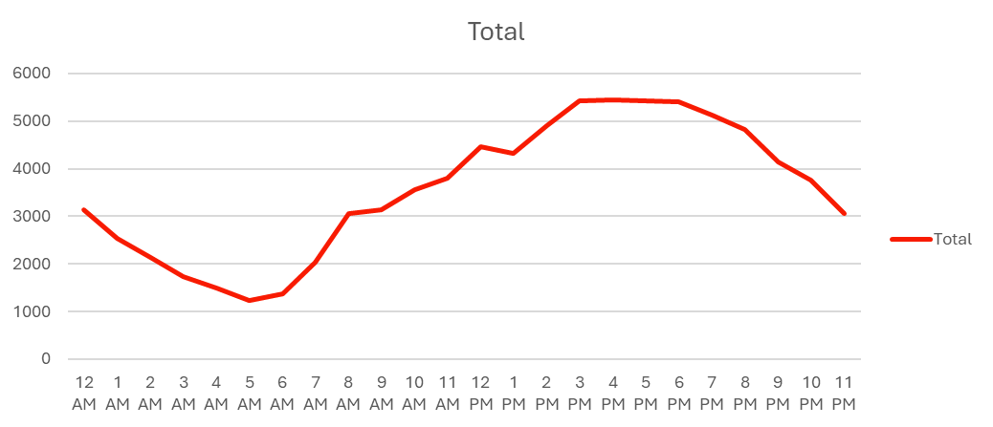
Time Analysis of Crimes
Hypothesis: Majority Crimes are committed at night.
Majority of crimes are committed between 3pm – 8pm in Brooklyn, 1pm-7pm in Manhattan, 1pm to 9pm in Bronx, 3pm to 8pm in Queens and 1 pm to 9pm in Staten Island.
Majority crimes are committed in the day light between 3 to 7pm which negates the hypothesis.
Total Number of crimes reported per hour in NY

Slide 19
Recommendations based on Initial Data observation
The peak times when crimes are committed coincide with the office timings and hence residents need to ensure proper surveillance devices are in place (e.g. alarm systems, cameras)
Local police authorities need to be more vigilant during these hours of the day and can patrol the areas where crimes are reported more frequently.

Slide 20
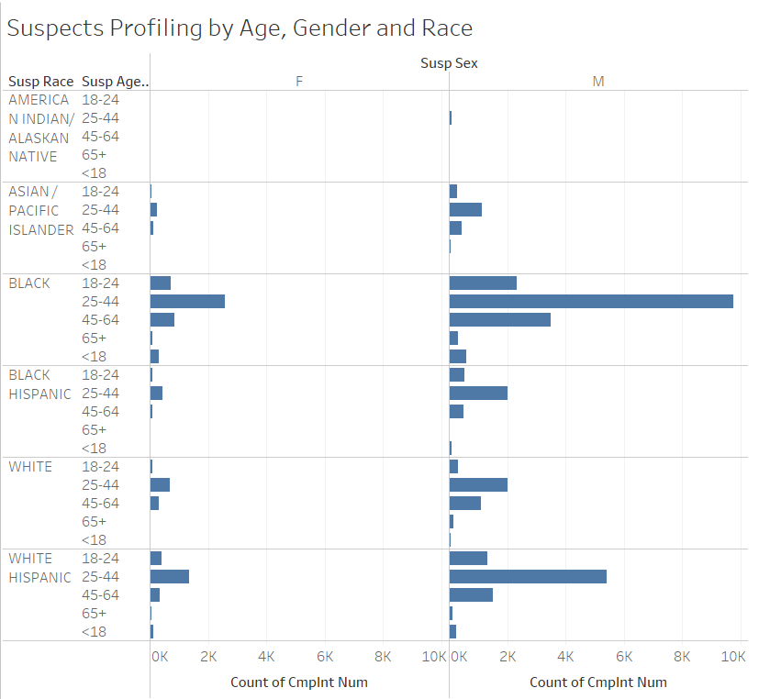
Suspect Profiling
Observation:
Based on the number of complaint that described the suspect profile, we can see that majority or suspects are male.
Also, highest number of suspects belong to the age bracket 25-44 years and race ‘Black Race’.
Note: Many complaints had no profiling of the suspects. Analyzing the profile only where the exact profiles of the suspects is known.

Slide 21
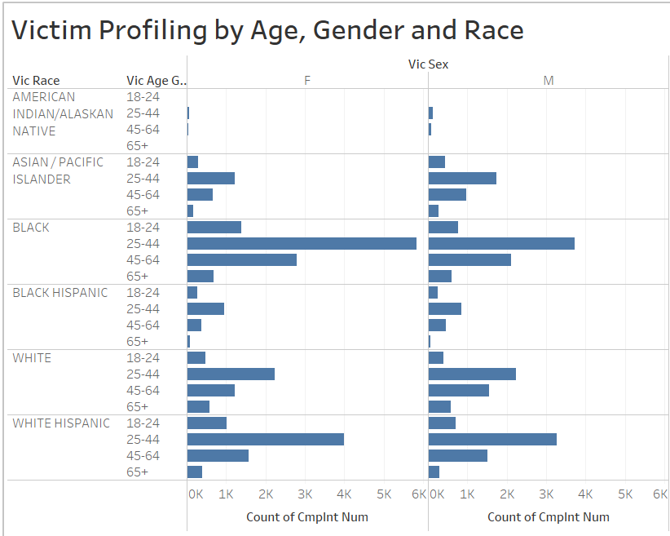
Victim Profiling
Observation:
Female and Male in the Age bracket 25-44 years are major targets followed by age group 44-65 years.
We can conclude from the graph that individuals belonging to ‘Black and White Hispanic’ Race are common victims.
Female victim are more than male victims.

Slide 22
Recommendations:
Analyzing the suspect profiles and victim profiles can help the government understand the reason behind the crimes and the psychology of the criminals.
Analyzing the victim profiles can help us generate awareness amongst the residents and tourists.

Slide 23

THANK YOU!

